Slide 1
COURSE MANAGEMENT SYSTEM
SREEKANTH KUMAR VOBILISHETTY
AKHILA YARLAGADDA
PIYUSHA VARSHINI TIRUKOVALLURU
MEGHANA REDDY AKKATI

Slide 2
DESCRIPTION
Course registration system is a website where students from various departments in a university can register for courses of their choice online.
ADD
DROP
SWAP

Slide 3
TECHNOLOGIES USED
Java Spring Boot-Tool
Javascript
HTML
CSS
JSP

Slide 4
ENVIRONMENT
Spring Tool Suite 4-4.2.0
Visual Studio
GitHub

Slide 5
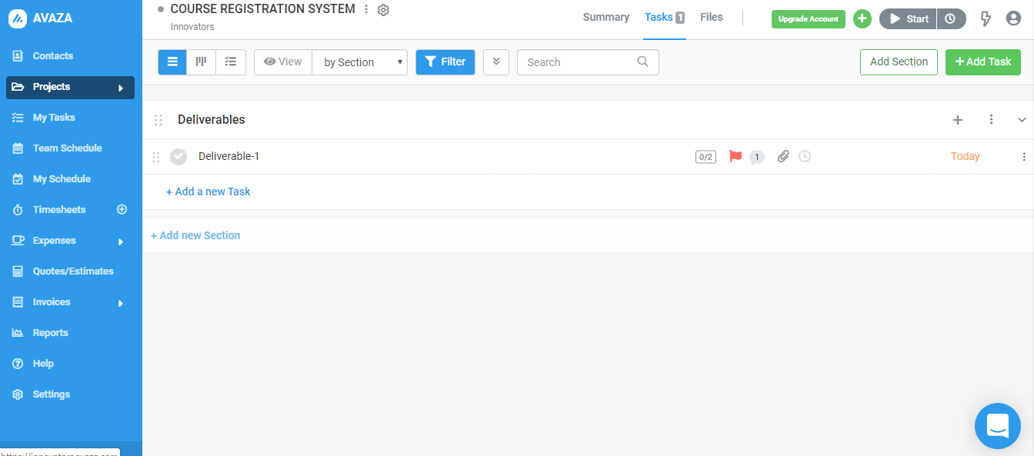
PROJECT MANAGEMENT TOOL

Slide 6
RISK MANAGEMENT
GENERIC RISKS
Schedule Risk: Schedule risk is a most common risk in any software/web development projects.

Slide 7
PROJECT SPECIFIC RISKS
Password storage risk: If the admin password is compromised, there is a risk of whole website compromise and finance information leakage. If the password list of all students is stored directly in database, they can be accessed easily which may lead to accounts hack.
Ability to store and access curriculum information effectively: As this project would include large curriculum information such as lot of departments, courses and their schedules, there is a high chance of confusion to store/access this information.

Slide 8
CONTINGENCY PLAN
Mitigation: We first plan to accomplish the basic requirements of the system like system logic, exception handling, test cases etc. keeping track of the time availability. We also plan to integrate all parts of the code every now and then to confirm the compatibility. Later, we decide on developing additional/optional features

Slide 9
Mitigation
We plan to implement a password encryption mechanism while storing passwords in database.
First, we analyze all the information like what all departments and courses we would have and provide unique codes for each course which may lower this risk.

Slide 10
THANK YOU

